Slide 1
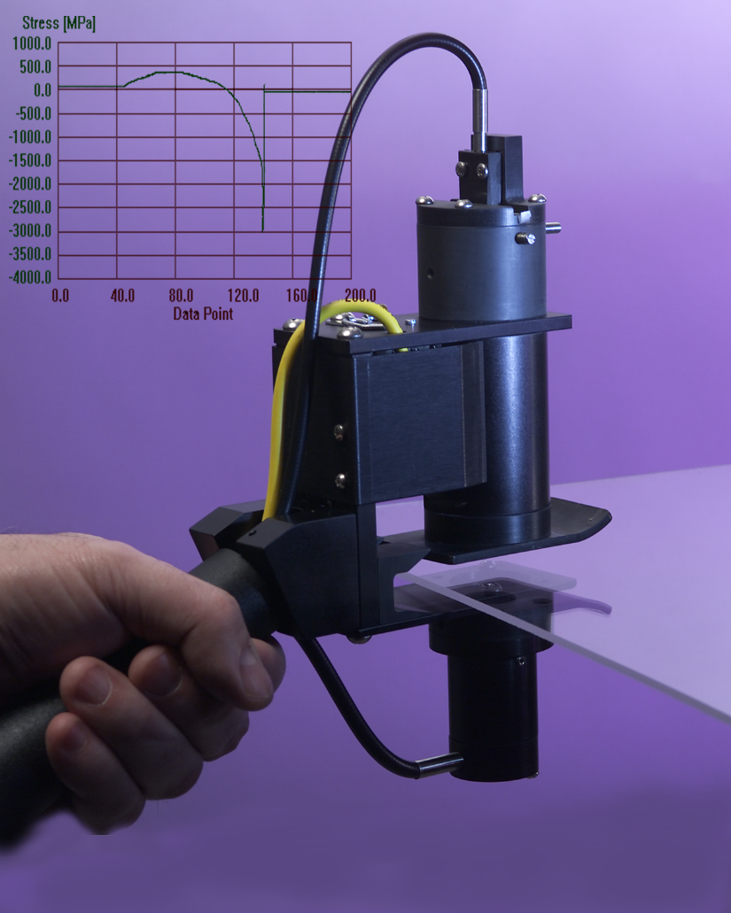
Strainoptics
PES-100 Edge Stress Measurement System

Slide 2
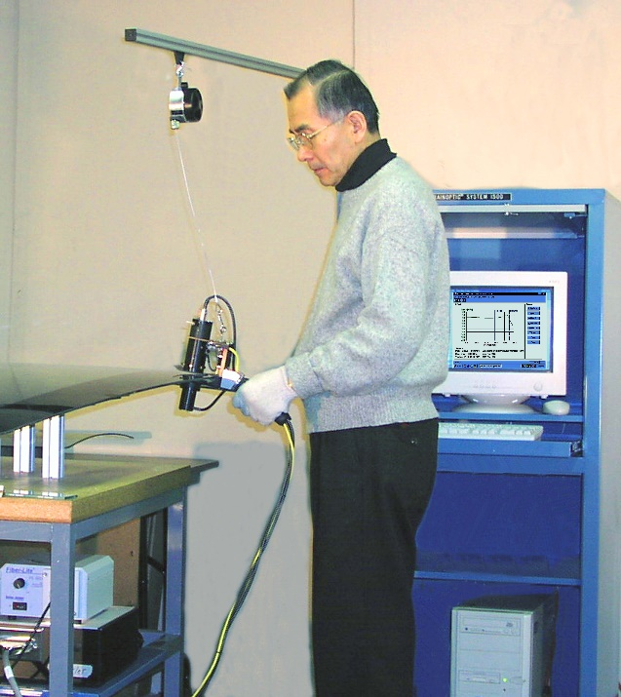
Model PES-100 Stress Measurement System
Features and Benefits:
Automatically measures and plots stress or retardation vs. position
Ideal for automotive glass applications
Portable operation for fast QC
Variety of data storage options
Single-point, multiple-point, and auto-scan modes
Works with tempered or heat- strengthened glass
Click button to go to next slide.

Slide 3
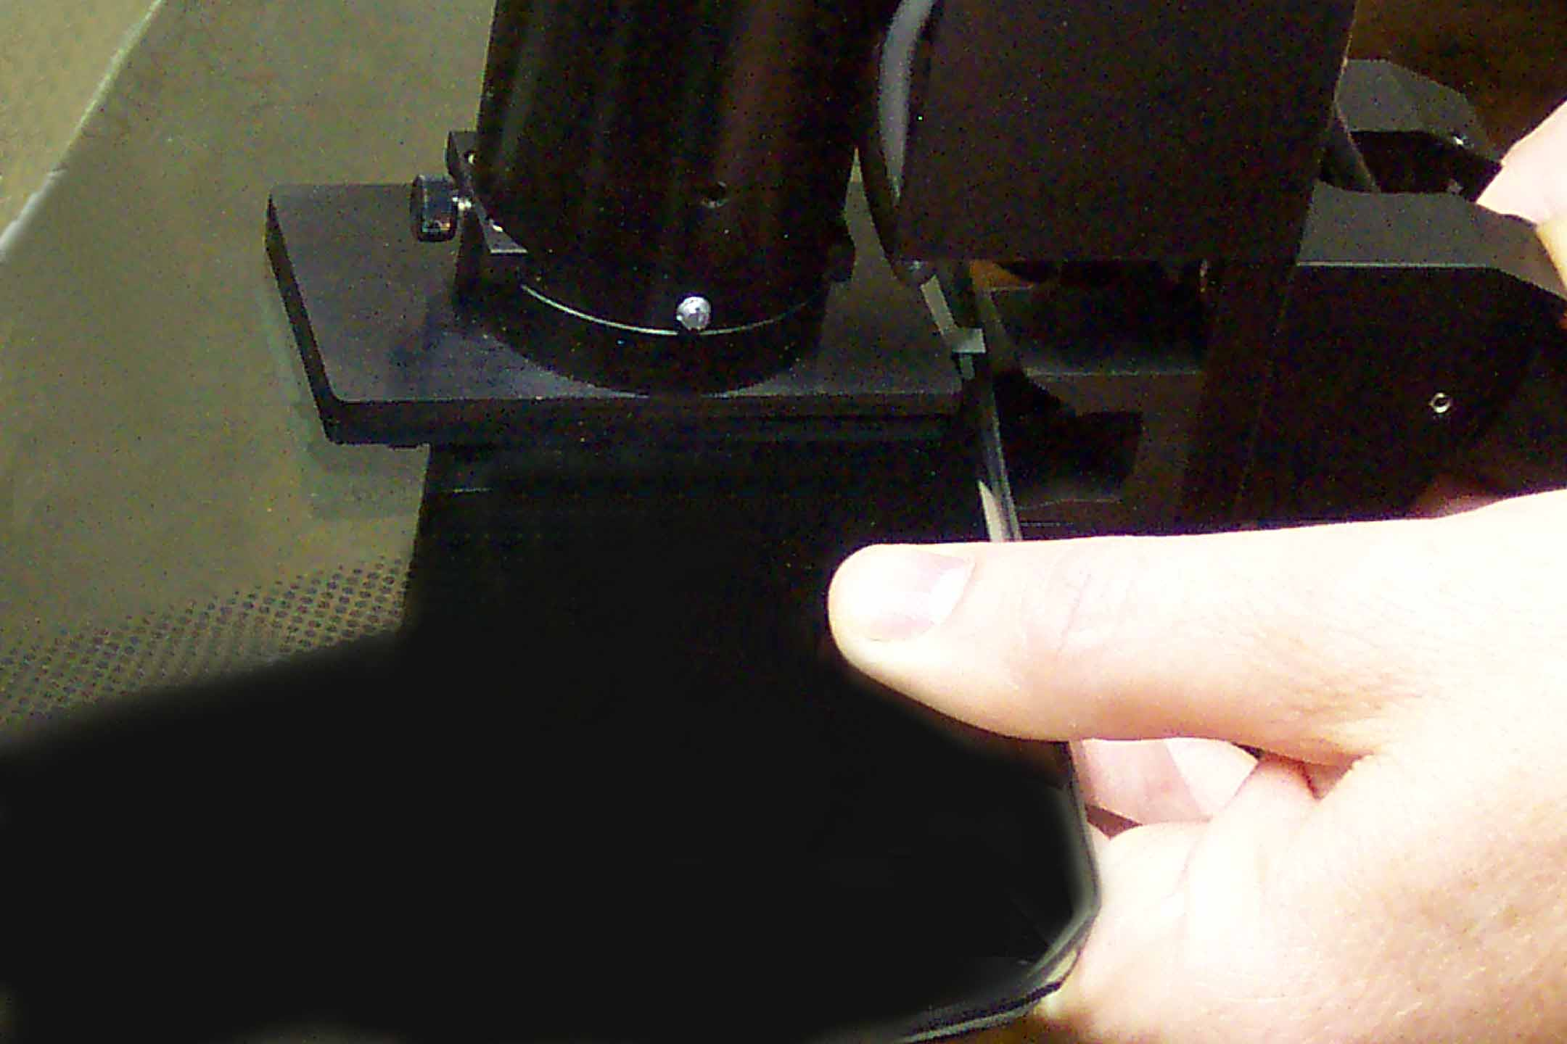
Model PES-100 Stress Measurement System
The operator uses a lightweight, portable scan-head to make a single line-stroke at each edge measurement location.

Slide 4
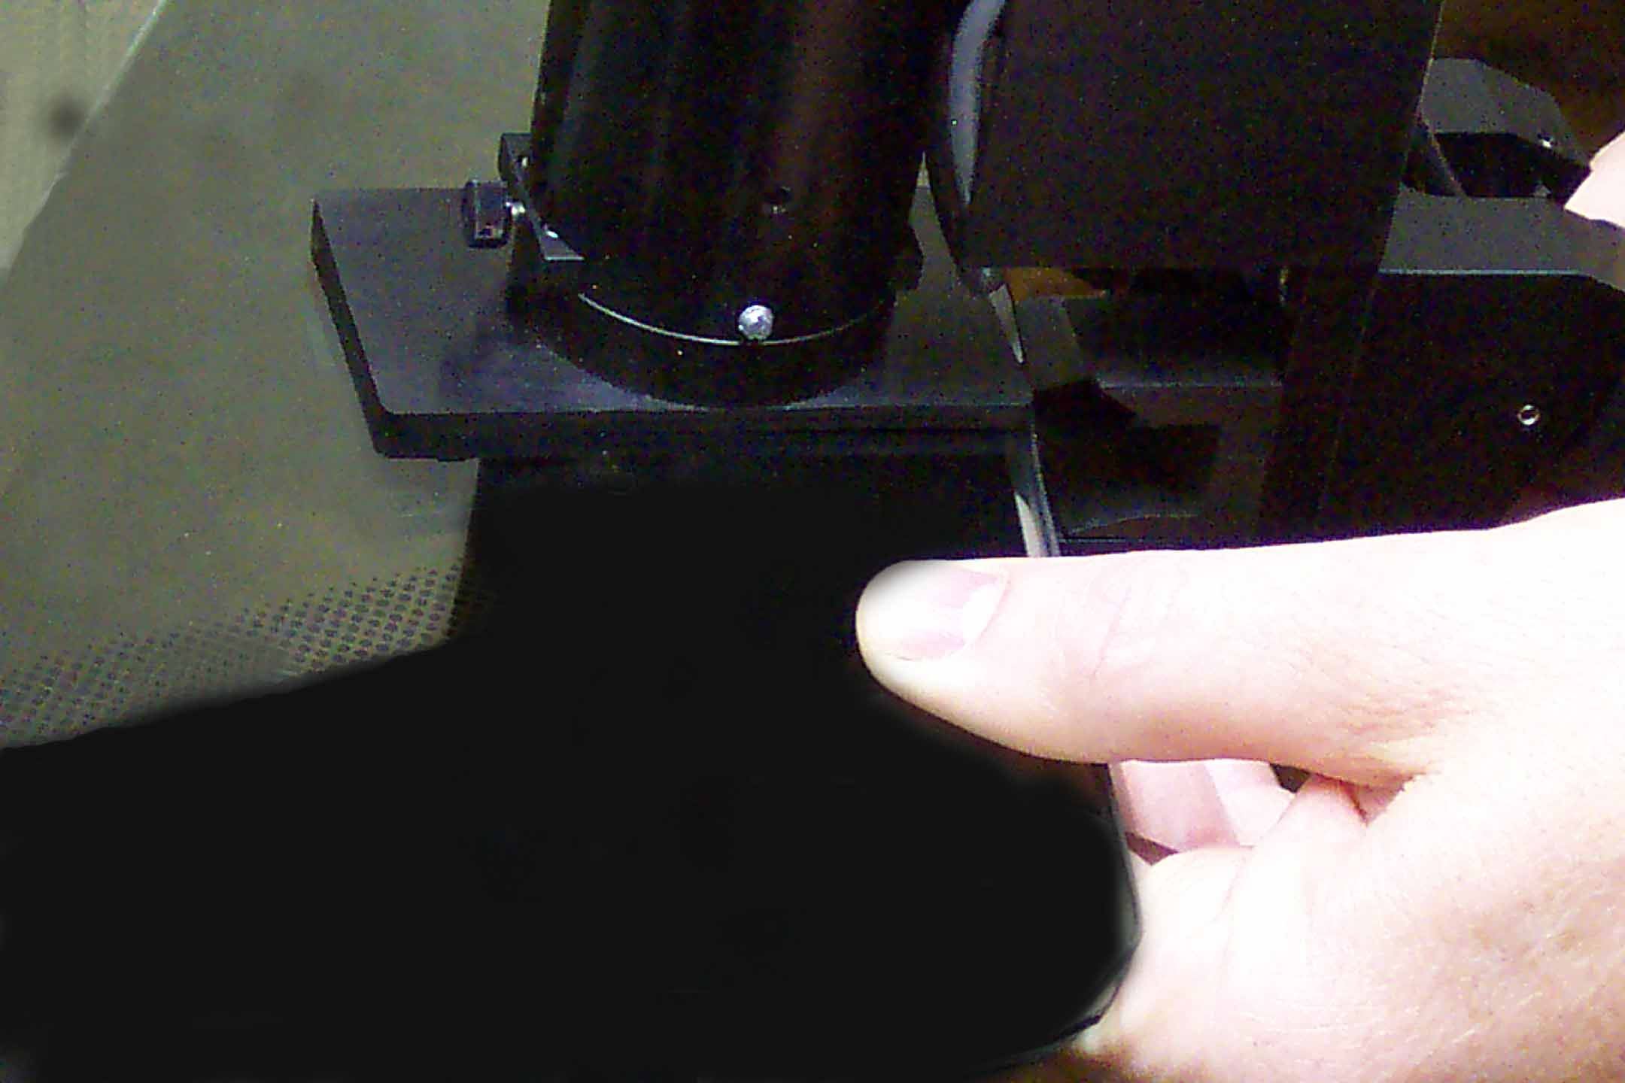
Model PES-100 Stress Measurement System
The operator uses a lightweight, portable scan-head to make a single line-stroke at each edge measurement location.

Slide 5
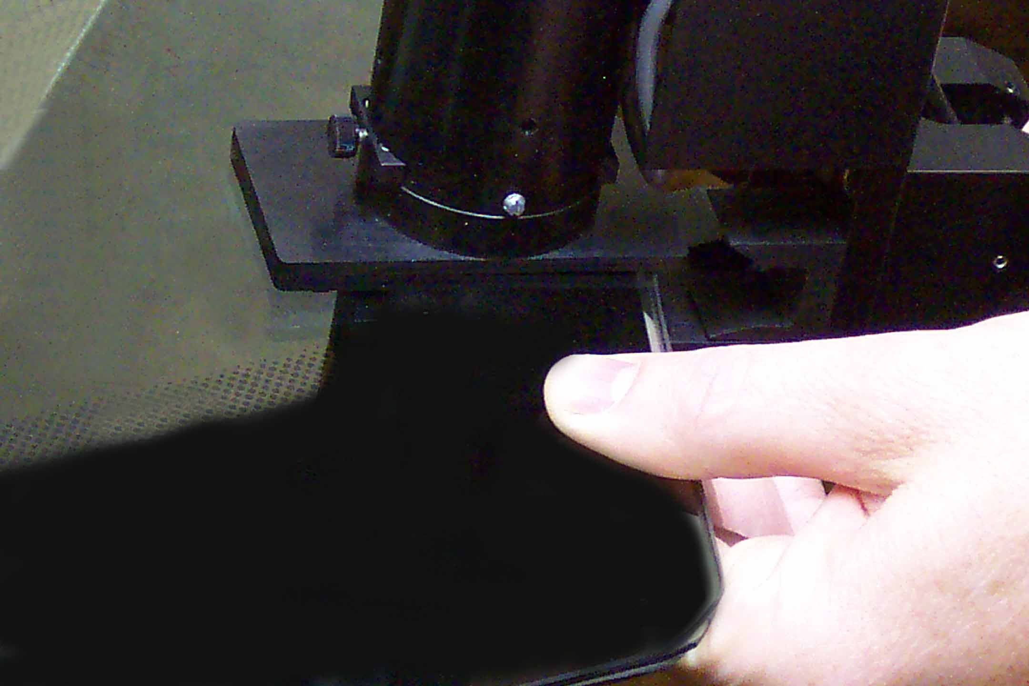
Model PES-100 Stress Measurement System
The operator uses a lightweight, portable scan-head to make a single line-stroke at each edge measurement location.

Slide 6
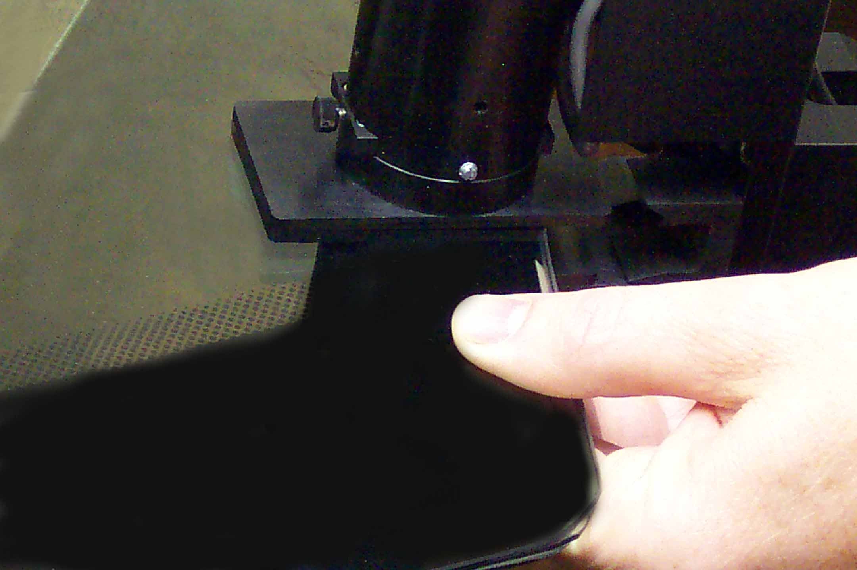
Model PES-100 Stress Measurement System
The operator uses a lightweight, portable scan-head to make a single line-stroke at each edge measurement location.

Slide 7
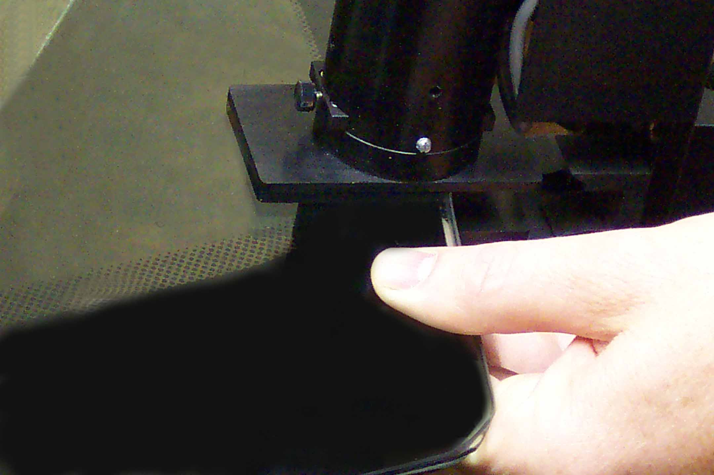
Model PES-100 Stress Measurement System
The operator uses a lightweight, portable scan-head to make a single line-stroke at each edge measurement location.

Slide 8
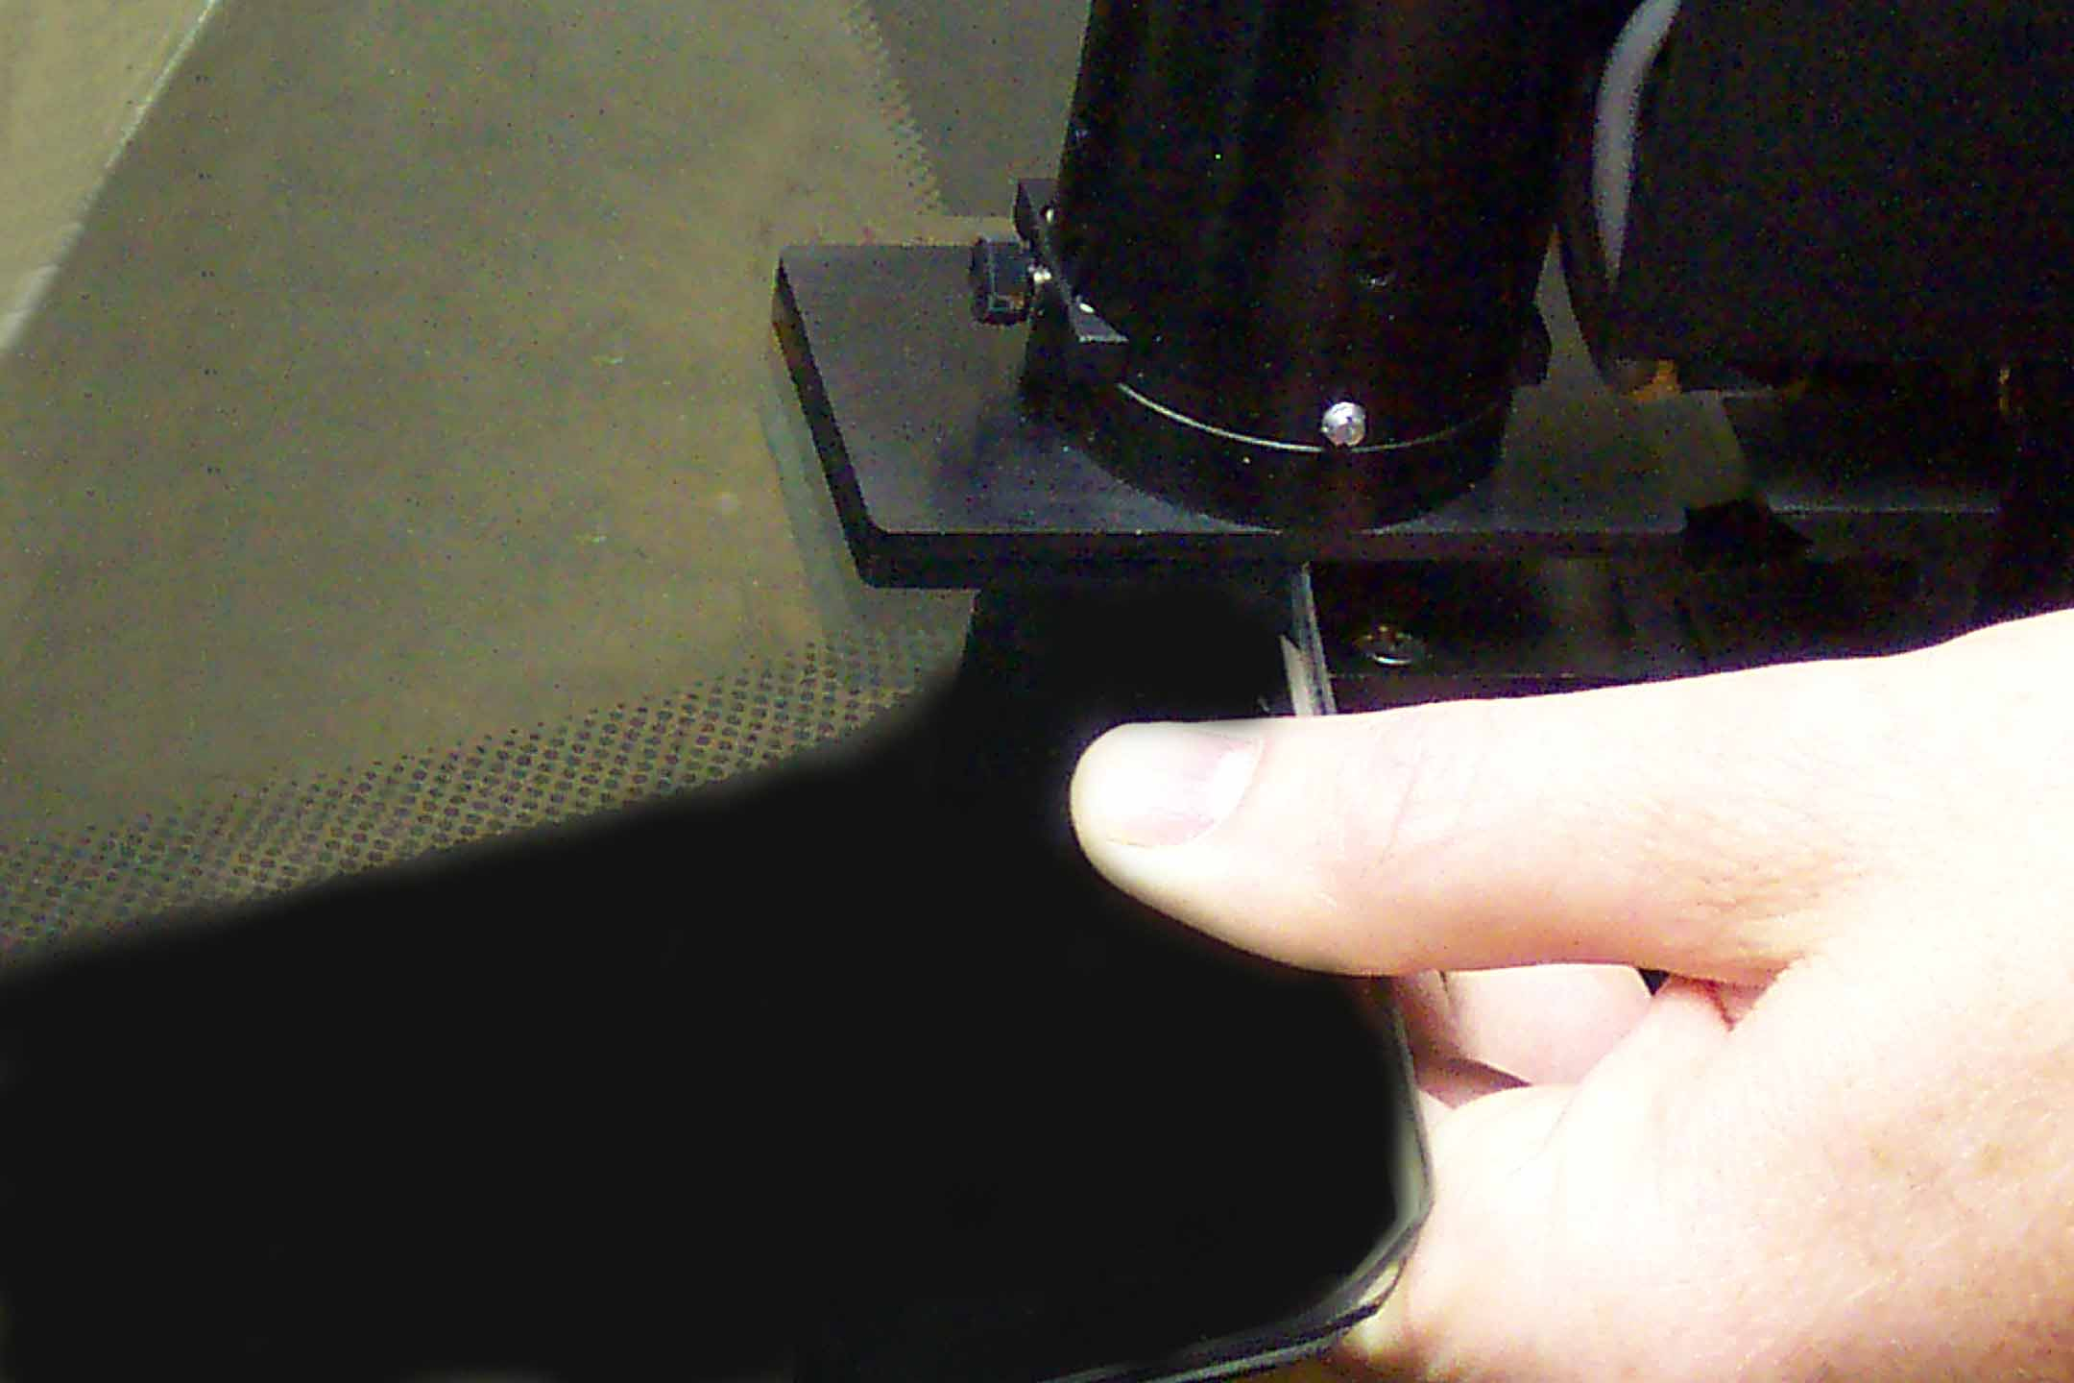
Model PES-100 Stress Measurement System
The operator uses a lightweight, portable scan-head to make a single line-stroke at each edge measurement location.

Slide 9
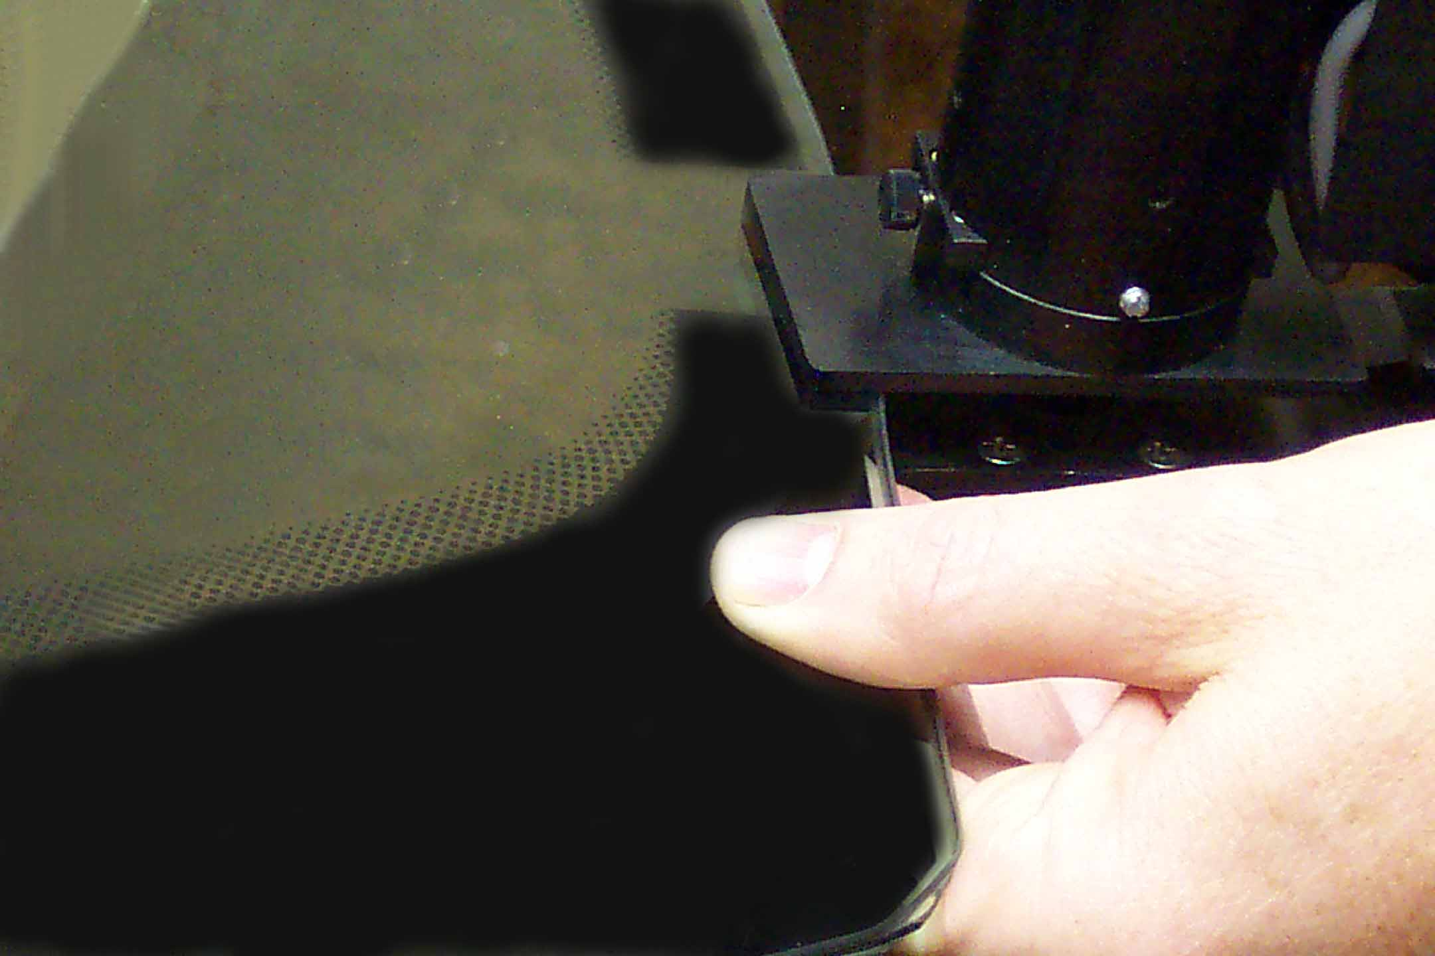
Model PES-100 Stress Measurement System
The operator uses a lightweight, portable scan-head to make a single line-stroke at each edge measurement location.

Slide 10
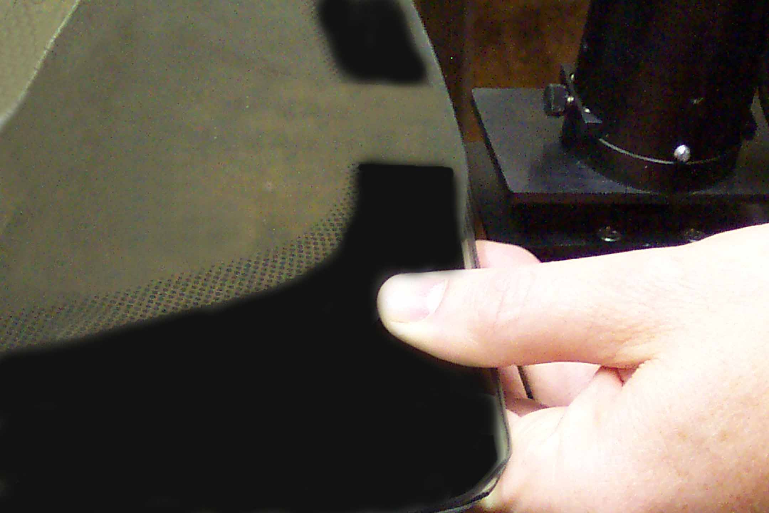
Model PES-100 Stress Measurement System
The operator uses a lightweight, portable scan-head to make a single line-stroke at each edge measurement location.
Click button to go to next slide.

Slide 11
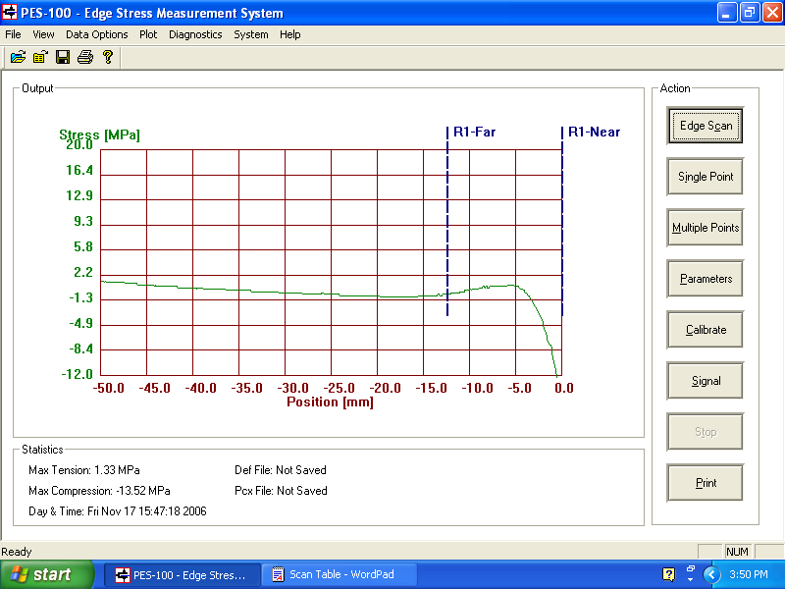
Model PES-100 Stress Measurement System
A graph is produced for each scan showing the stress profile in either stress units or retardation from 50 mm out to the edge.

Slide 12
Model PES-100 Stress Measurement System
Users may define a specific region of interest to be measured and highlighted

Slide 13
Model PES-100 Stress Measurement System
The software also displays a table of maximum compression and maximum tension for a single edge scan or a set of edge scans, as well as maximum tension for the user-defined region of interest (R1).

Slide 14
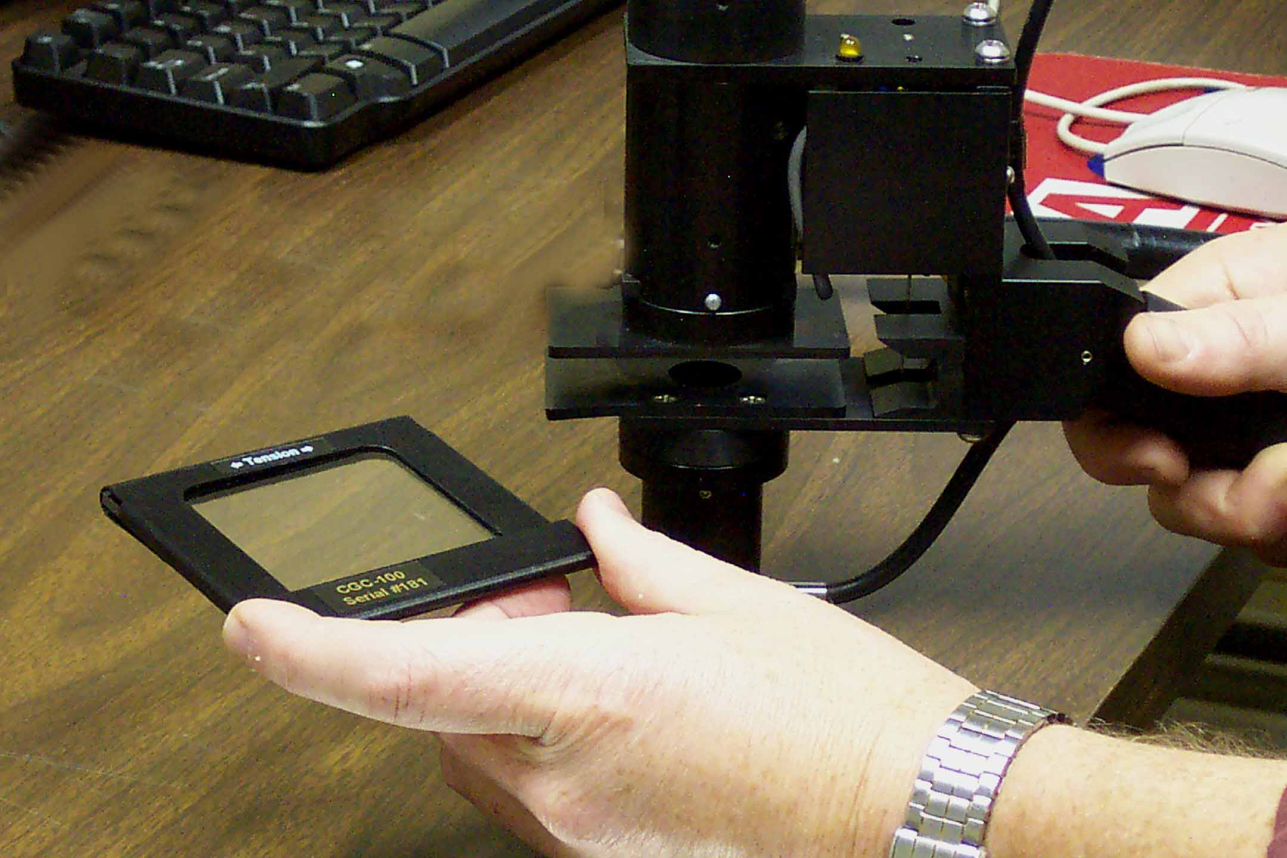
Model PES-100 Stress Measurement System
Instrument measurement accuracy is verified by taking a single-point measurement on the supplied reference standard, which exhibits a known value of retardation.

Slide 15
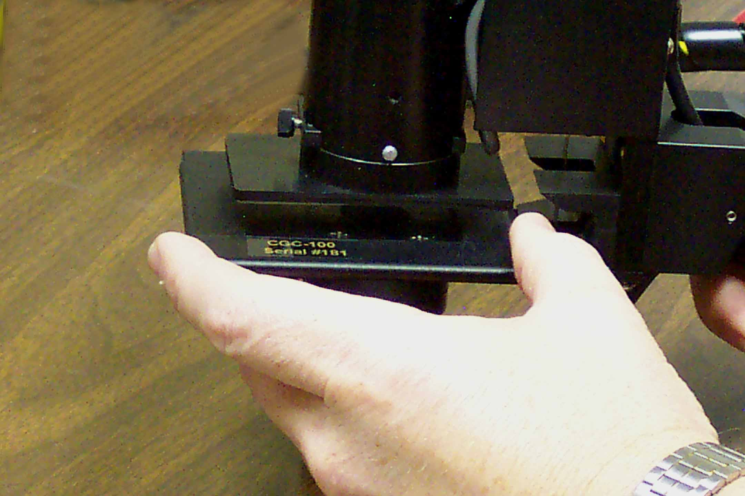
Model PES-100 Stress Measurement System
The reference retarder verifies that the instrument is measuring within specifications and also recognizing the type of stress being measured (tension or compression).

Slide 16
Model PES-100 Stress Measurement System
Main Application Window
Prompts, results, and graphs appear in this section.

Slide 17
Model PES-100 Stress Measurement System
Main Application Window
Statistics appear in this section.

Slide 18
Model PES-100 Stress Measurement System
Main Application Window
Automatic measuring along a scan line

Slide 19
Model PES-100 Stress Measurement System
Main Application Window
Measuring at any selected location (Single Point)

Slide 20
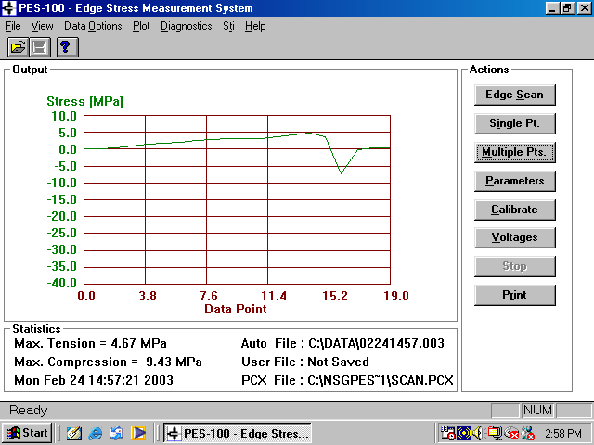
Model PES-100 Stress Measurement System
Main Application Window
Measuring at multiple locations (Multiple Point)

Slide 21
Model PES-100 Stress Measurement System
Main Application Window
Default and user-defined parameters

Slide 22
Model PES-100 Stress Measurement System
Main Application Window
Auto-calibration

Slide 23
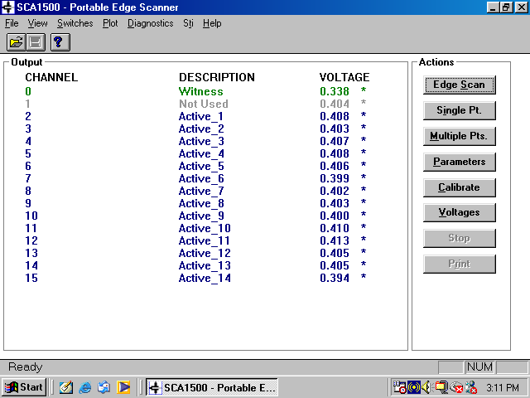
Model PES-100 Stress Measurement System
Main Application Window
Signal quality monitor

Slide 24
Model PES-100 Stress Measurement System
Main Application Window
Print screen data to specified device

Slide 25
Model PES-100 Stress Measurement System
Main Application Window
Data Options

Slide 26
Model PES-100 Stress Measurement System
Main Application Window
Plot Type (Stress or Retardation)

Slide 27
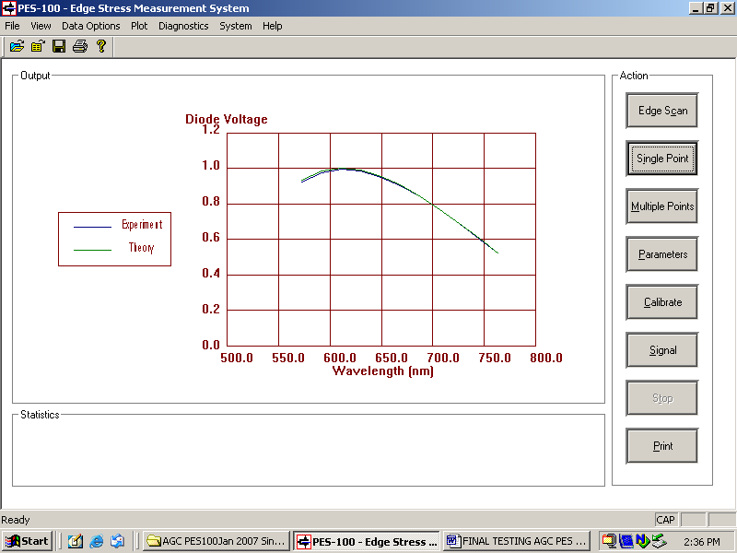
Model PES-100 Stress Measurement System
Main Application Window
Diagnostic Information

Slide 28
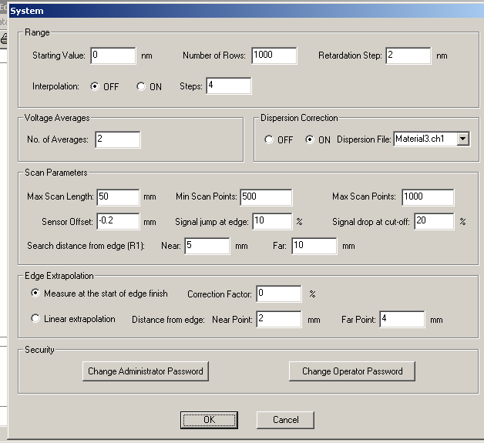
Model PES-100 Stress Measurement System
Main Application Window
System and Factory Settings

Slide 29
Model PES-100 Stress Measurement System
The PES-100 Edge Stress Measurement System is based on the field-proven and patented Strainoptics’ Spectral Contents Analysis (SCA) method, used around the world by leading glass manufacturers and fabricators.
While the instrument is designed primarily for automotive glass measurement, it is also well suited for most architectural glass applications and the software can be easily modified to meet your specific production quality control requirements. Your inquiries are invited.

Slide 30
For more information on the PES-100 Edge Stress Measurement System or any of our other instruments for measuring stress or optical distortion, contact your authorized Strainoptics distributor, visit our website, or call or email us directly.
Strainoptics 108 W. Montgomery Ave. North Wales, PA 19454 USA Tel: 215.661.0100 Fax: 215.699.7028
stress@strainoptics.com www.strainoptics.com

